Slide 1

A Minesweeper Game

Slide 2
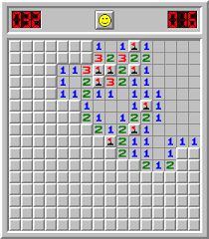
What is Minesweeper?
Initially a blank board
Press spots to reveal information about mines placement
Lose if pressing a mine
Win if all spots but the mines are revealed

Slide 3
My take on the game

Slide 4
Overview of the program
Generate indexes
Generate mine board
Generate game board
Until game ends: Display game board and ask player for a move

Slide 5
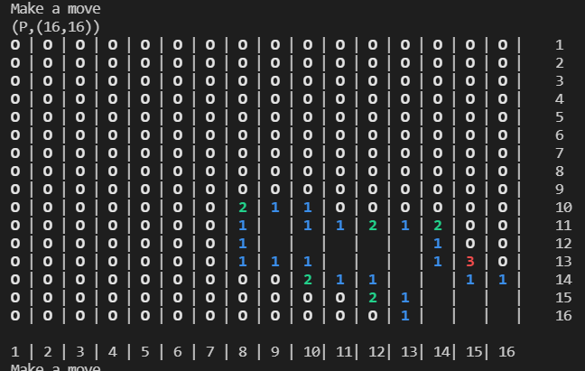
An interesting detail
How to reveal several spots when a blank spot has been pressed?
First check if the spot is blank
If so, check all surrounding
If any of those are blank, check their surrounding, and so on
Important to end the recursion
This is done by only checking the white spots – the number of white spots will then decrease each recursion

Slide 6
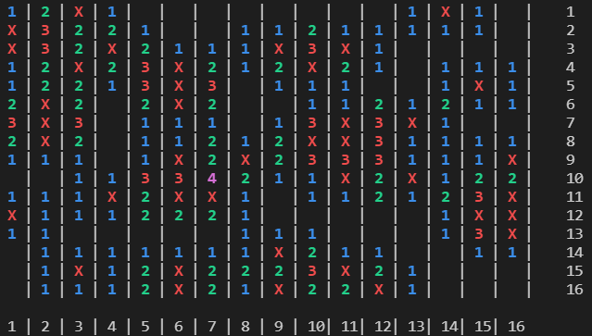
Difficulties
Getting the accurate value of each spot
Problem: the edges of the game board should not count mines “over the edge”
Solution: mine boards are the initial board. We then find the surrounding spots by using column-row indexes and exclude those that are out of range.

Slide 7
Questions?

